Slide 1
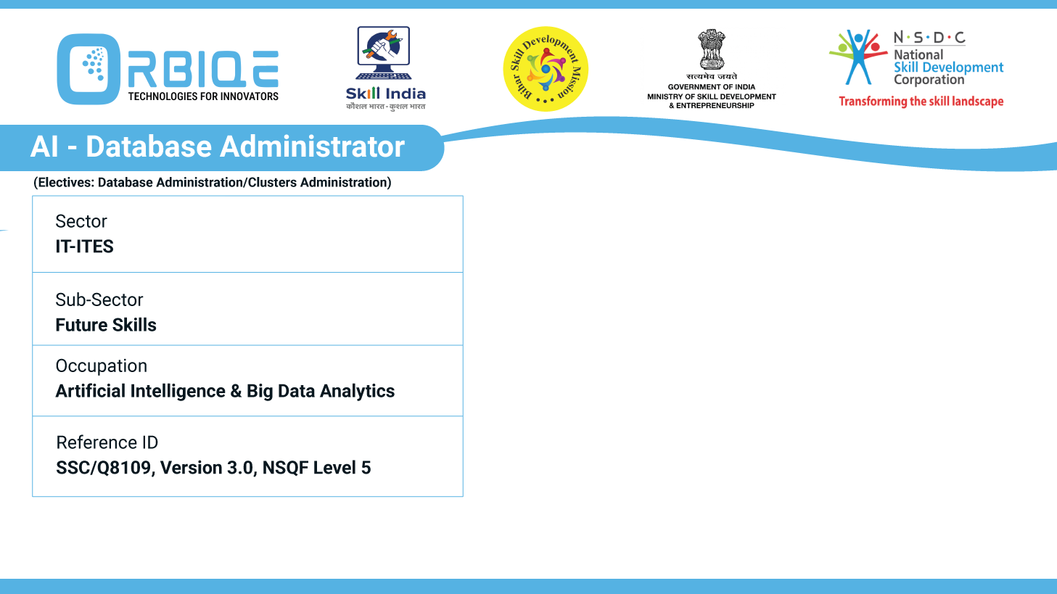

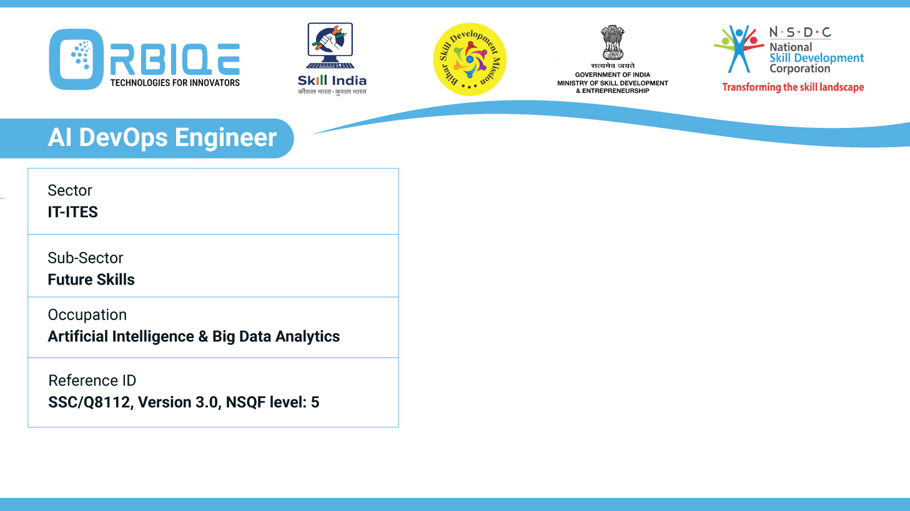
Name- Krishna Kant Dubey

Slide 2

File System Mastery: Storing Data in Various Formats

Slide 3
Agenda
Utilize different file systems proficiently to store structured, unstructured, or semi structured data
Ensuring effective data management across diverse file types

Slide 4
Utilize different file systems
To handle various types of data—structured, semi-structured, and unstructured—file systems play a key role in how efficiently you store, retrieve, and manage them.
Here's a breakdown of how different file systems can be leveraged, especially with your interest in DevOps and backend architecture
Structured Data
Semi-Structured Data
Unstructured Data

Slide 5
Structured Data
Typically tabular and stored in databases—but if you're using file systems:
Recommended File Systems:
NTFS / ext4: Reliable for transactional logs and relational DB backups.
XFS / ZFS: Great for high-performance environments needing journaling and snapshot features.
Storage Formats:
CSV, Parquet, Avro: Optimized for structured query engines and analytics (e.g. Apache Hive, Spark).
Often stored in data lakes backed by file systems like HDFS or cloud equivalents like Amazon S3.

Slide 6
Semi-Structured Data
Has organizational properties but no rigid schema—like JSON, XML
Recommended File Systems
HDFS (Hadoop Distributed File System): Handles large volumes with distributed scalability.
Amazon S3 / Azure Blob / GCS: Object storage ideal for flexible formats.
Storage Formats
JSON, YAML, XML: Popular in configuration management and APIs.
Can be queried using tools like MongoDB, Elasticsearch, or Presto

Slide 7
Unstructured Data
Think text files, images, audio, video—no fixed schema
Recommended File Systems:
Object Storage: Amazon S3, MinIO, Ceph—perfect for blobs, images, logs.
POSIX-compliant systems: ext4, NTFS for local storage of multimedia and logs.
Tools for Access & Management:
Indexing and search: Elasticsearch (logs, text), Apache Tika (document metadata).
Streaming and processing: Apache Kafka + Spark for ingestion and real-time analysis.

Slide 8
Data Management
Classification & Tagging
Choose the Right Storage Strategy
Security & Access Controls
Data Lifecycle Management
Monitoring & Auditing
Data Integration & Querying
Automation & DevOps

Slide 9
Classification & Tagging
Apply metadata and tags to identify the type, source, and sensitivity of each file.
Use automated tools like Apache Tika or AWS Macie to classify content (especially unstructured data)

Slide 10
Choose the Right Storage Strategy
Data Type | Suggested Storage | Notes
Structured | RDBMS (PostgreSQL, MySQL), Parquet on S3 | Great for transactional and analytical workloads
Semi-Structured | NoSQL (MongoDB, DynamoDB), JSON/XML files in object storage | Flexible schema handling
Unstructured | Object storage (S3, Azure Blob), Distributed FS (HDFS, Ceph) | Ideal for images, audio, logs, large documents

Slide 11
Security & Access Controls
Implement RBAC (Role-Based Access Control) or ABAC (Attribute-Based Access Control).
Encrypt sensitive files at rest and in transit (AES, TLS).
Leverage IAM policies in cloud systems for granular permissions.

Slide 12
Monitoring & Auditing
Track access, modifications, and anomalies using logs.
Tools: Elasticsearch + Kibana, Splunk, AWS CloudTrail

Slide 13
Data Integration & Querying
Implement a data lake or warehouse for cross-type querying.
Use platforms like Apache Hive, Presto, or Athena to query files stored in different formats and file systems

Slide 14
Automation & DevOps
Automate ingestion pipelines with tools like Apache NiFi, Fluentd, or Airflow.
Leverage configuration management to ensure consistent data handling across environments.

Slide 15
Thank You

